Slide 1
Capstone Final Project
Kyle Navroth

Slide 2
Introduction
The purpose of this analysis is to take a look at the city of Philadelphia as a home buyer to determine which neighborhoods would be the best place to invest in. This information is useful mostly for two people; one being a family looking to purchase a home, and the other trying to make a business out of the purchase. The overall goal for both would be to see value and return in the investment, after all, it is a major purchase and one that needs careful consideration.

Slide 3
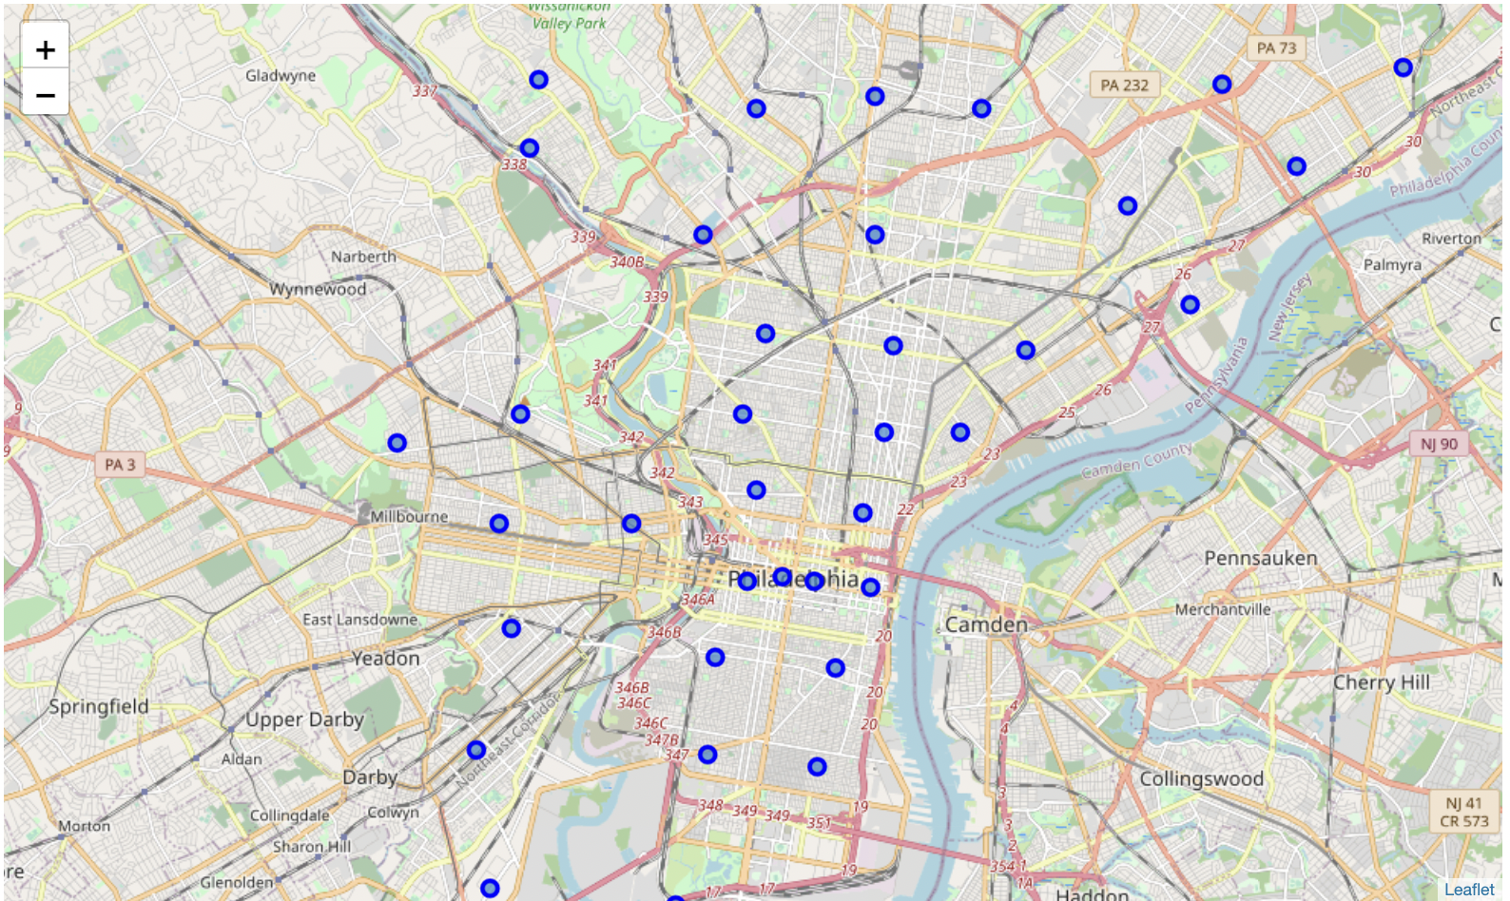
Map of Philadelphia

Slide 4
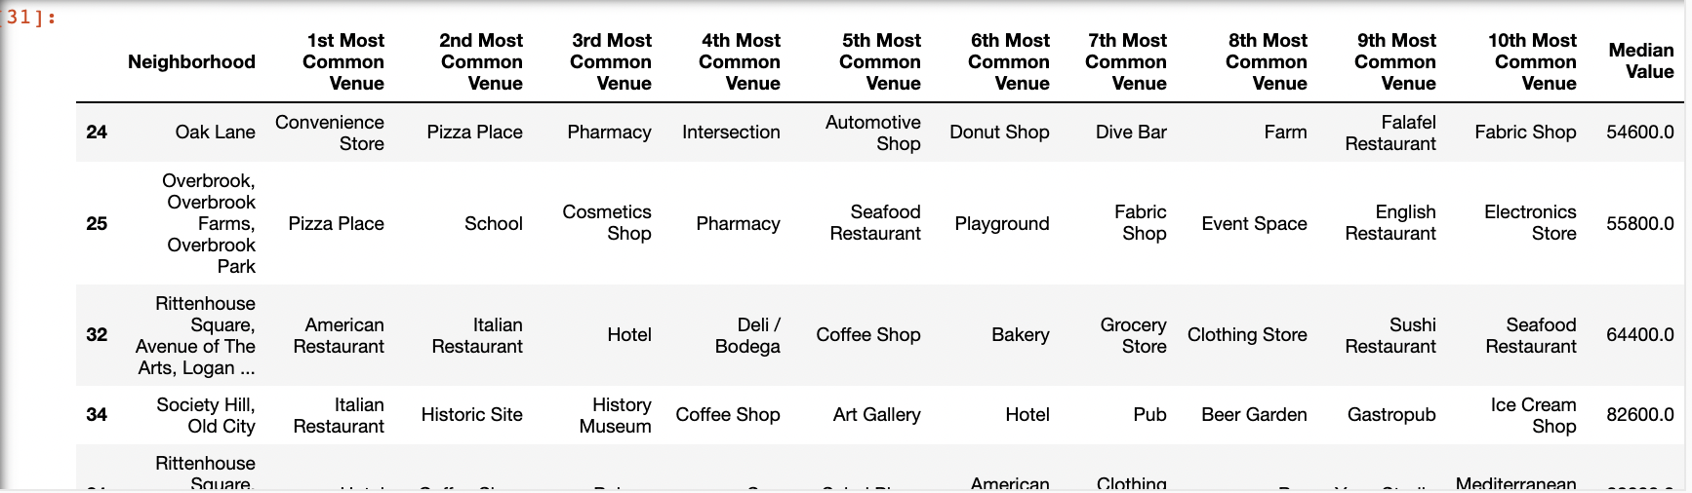
Snapshot of Table

Slide 5
Results
There is no conclusion to be made from this analysis, this project is open ended. The user will be able to analyze each neighborhood, it’s venues, and the median home value with the final table. The user will have to take their own preferences into account to determine which neighborhood will be best for them to purchase a home!

